Slide 1

World Happiness Visualization
Project 2
Data Analytics Bootcamp
June 23rd, 2018

Slide 2






Meet our Happy Team….

Slide 3
Technologies Used….
Dataset or API
Retrieving / Cleaning Data
Database
Web Visualization
Kaggle for CSV files on World Happiness
Python Dataframes, Numpy, Pandas
SQLite for Data Storage
D3.js and Plotly Graphical Visualizations
https://www.kaggle.com/unsdsn/world-happiness
Maps with mapbox (D3 Matplot.js)
Python Flask Routes for App.py
JSON calls (Python and Jscript) for data retrieval
HTML, CSS & BootStrap for additional Visuals

Slide 4
Questions for Audience Engagement
What are the top 10 happiest nations in the world? – Bar Chart (with happiness score)
What are the bottom 10 saddest nations in the world? – Bar Chart (with happiness score)
Show where these countries are in the world map as well – Green for happy countries and Red for Sad countries
Out of all the factors that make a nation ‘happy’, what are top 2 leading factors? What factors make a nation ‘happy’? What is the happiness criteria?
We will then show to the audience our top 5 Happiness factors – This will be a 3D Chart with 3 axis – Z will be Happiness Score, and X and Y will be our top 2 factors, and then the scatter plots will be our countries.
We calculate the weighted percentage of all individual factors for our top 10 countries – in a Pie Chart
Drop down to select each of the top 10 country (one selection at a time) which will change the pie chart accordingly
We then create a second Pie Chart where we average all 156 countries (happiness score average of all 156 countries), and weighted average of each of those 5 criteria
Then we show our analysis whether the data for top 10 countries matches the aggregate for all countries ….. This will be a pie chart as well
What is the most important factor for ‘you’ to be happy? Based on a sample of 5 different factors, show to the audience which country they should live in for each of the 5 factor. This means – show top 5 countries for each of the 5 happiness factors:
We should have a drop down selector for ‘happiness criteria – freedom, GDP, Life expectancy, Trust etc.’, and for each selection we should render top 5 and bottom 5 countries – 2 different Bar Charts for top 5 and bottom 5 countries. This way we tell the audience which countries to live in and which countries to stay away from based on the selection criteria

Slide 5
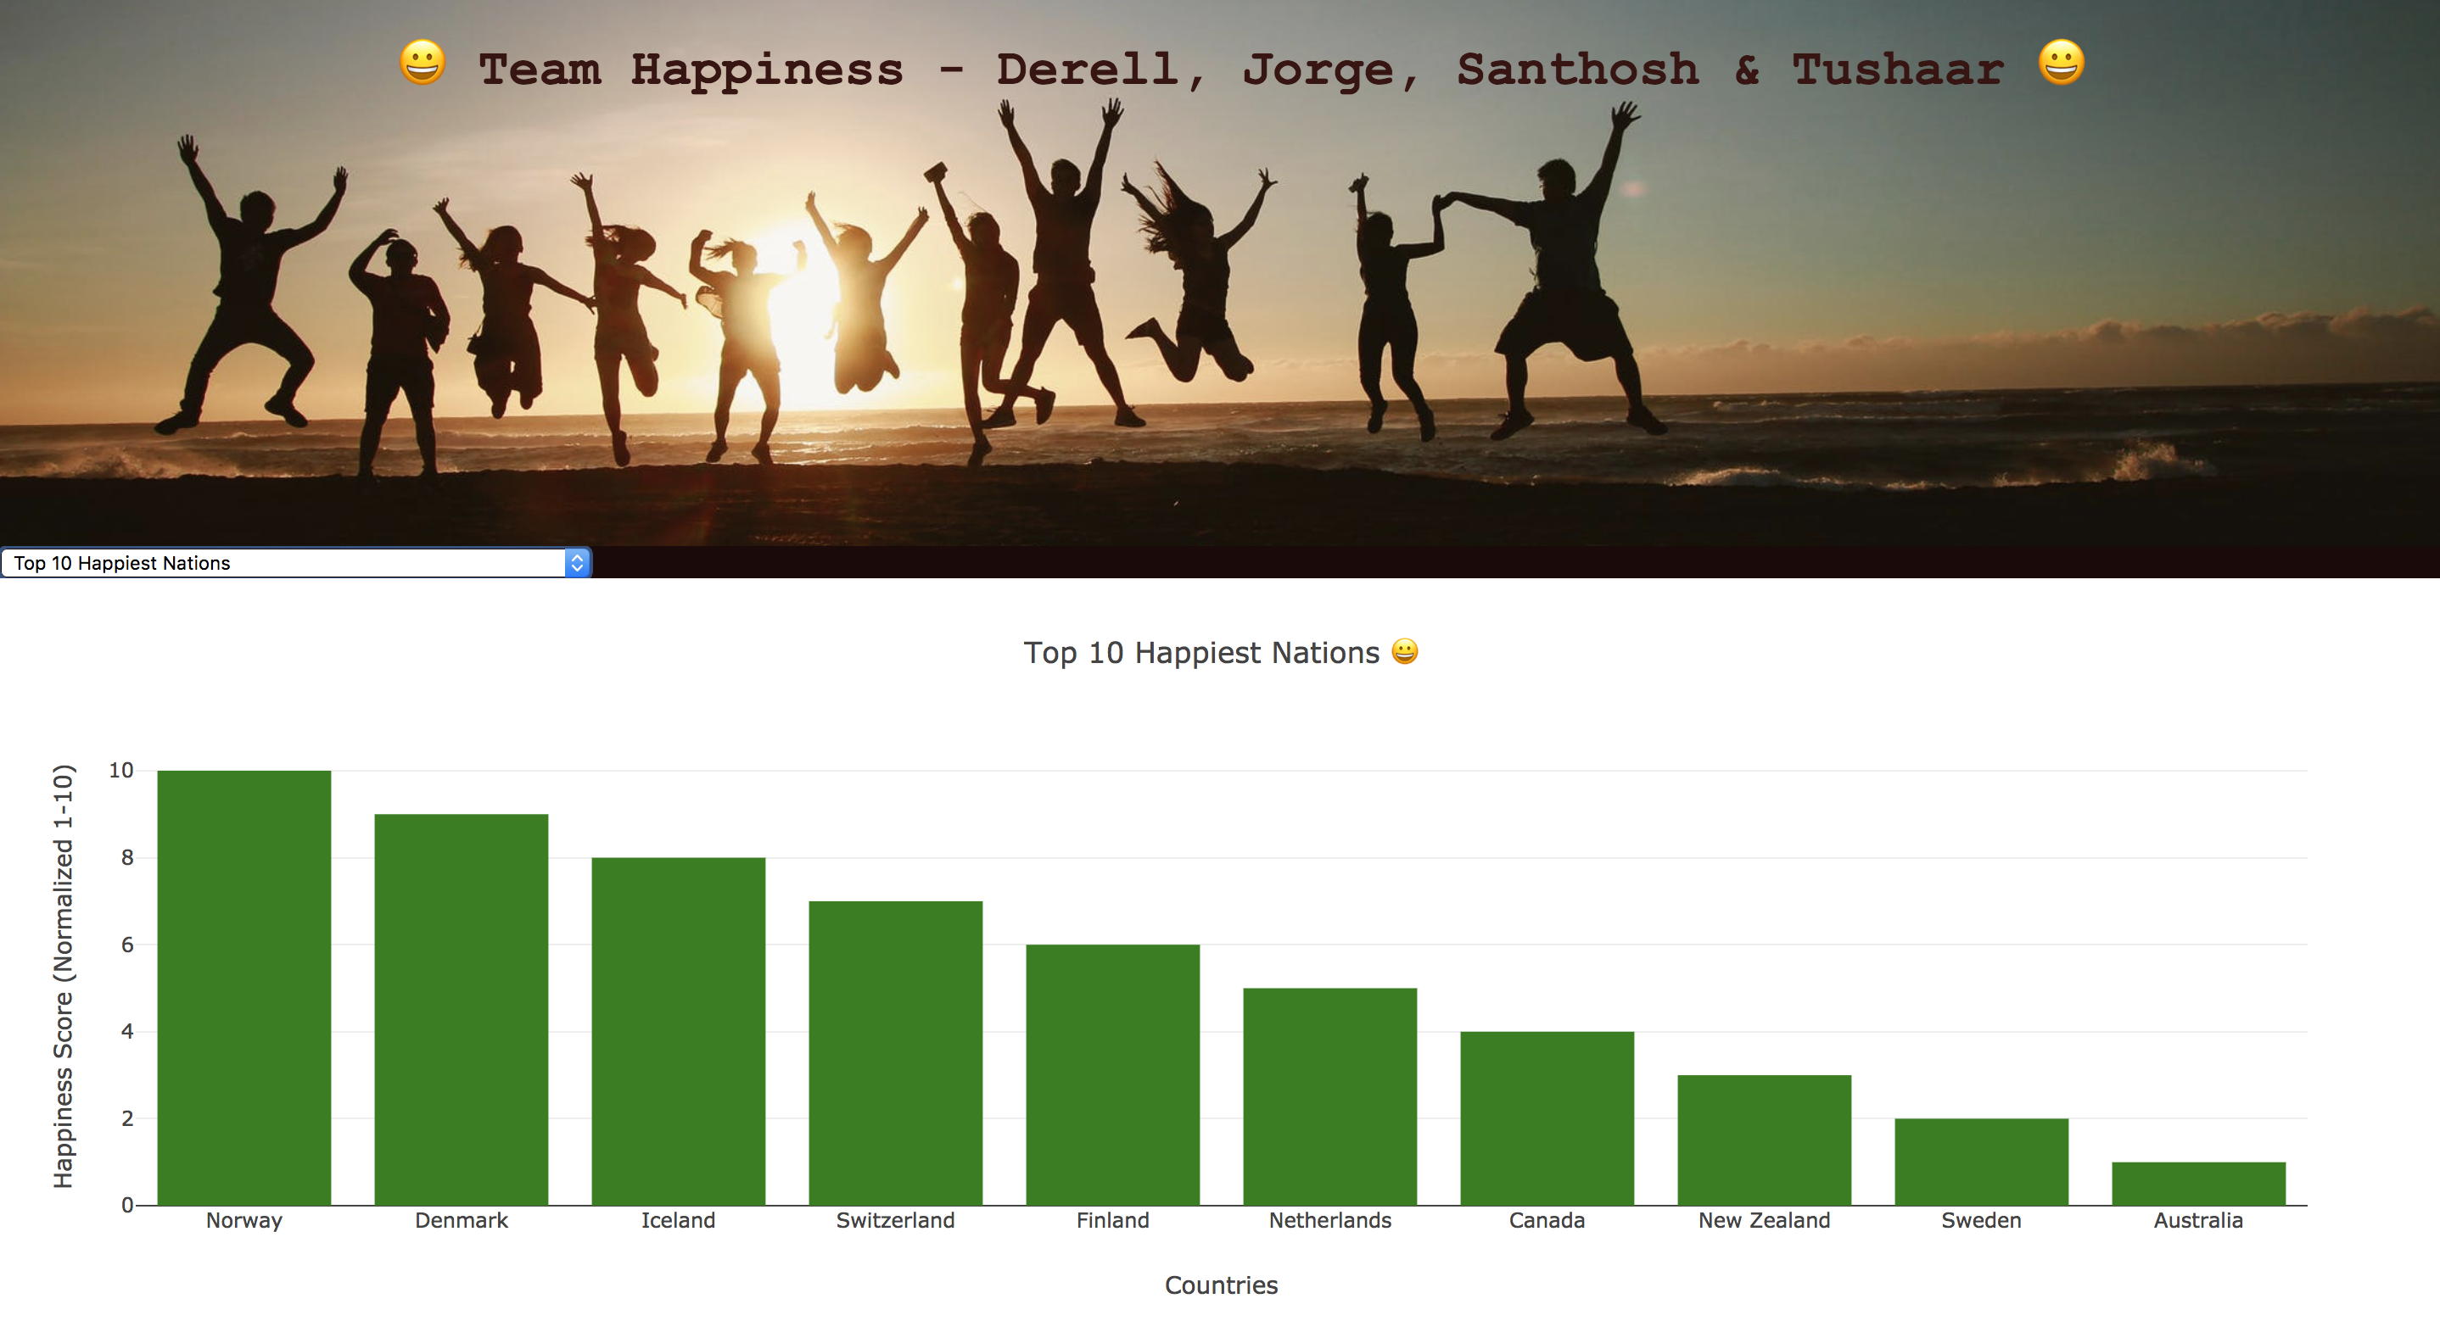
Some concept screenshots….

Slide 6
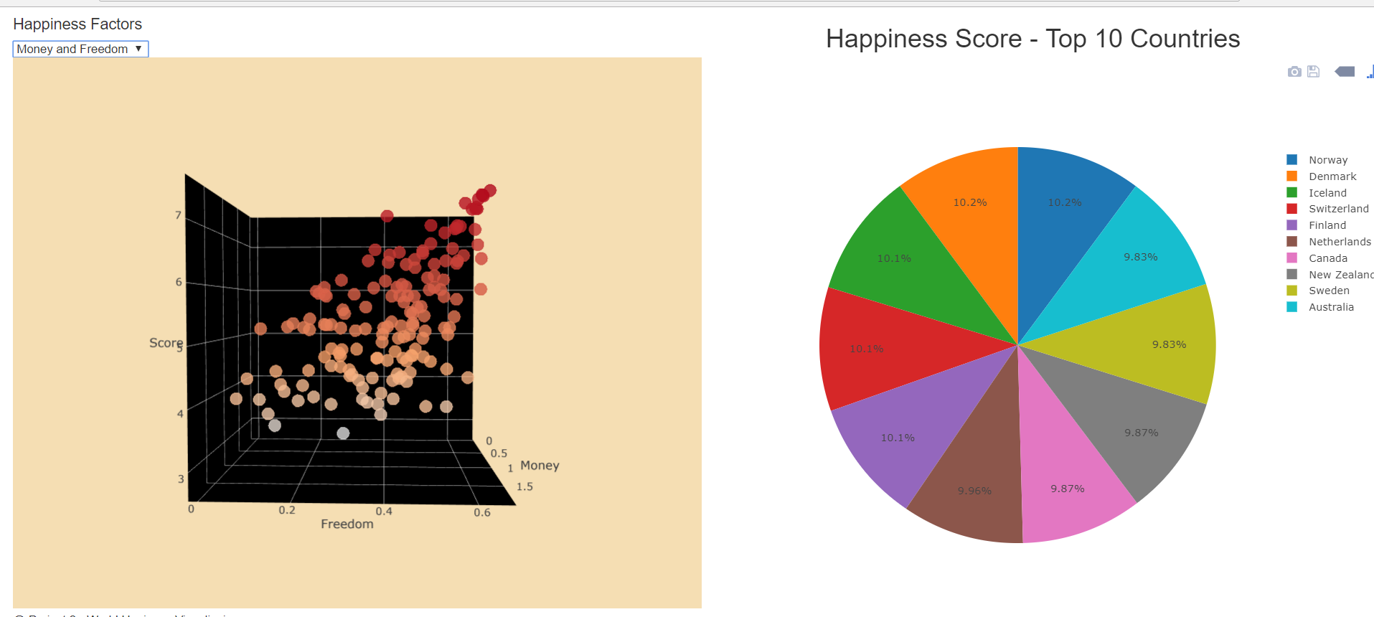
Some more concept screenshots….

Slide 7
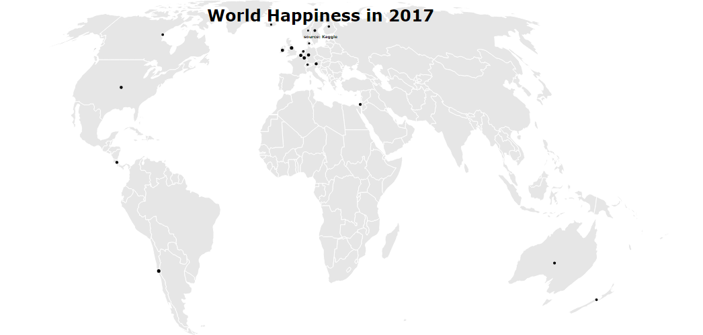
And more ☺…

Slide 8
Thank you!

